Slide 1
LLM Basics - Transformers
Dr. Aydede
SMU - NLP & LLM Workshop – August 28, 2024

Slide 2
While RNNs and LSTMs process input sequentially, the Transformer processes input in parallel, which allows it to be much faster and more effective for long-range dependencies
The Transformer architecture was introduced in the paper "Attention is All You Need" by Vaswani et al. It completely relies on self-attention mechanisms rather than recurrence, making it efficient and scalable

Slide 3
Step 1:
Tokenization: The text input is first tokenized into a sequence of tokens.
Embedding Layer: Each token is then represented as a vector in a high-dimensional space (word embeddings).
Positional Encoding: Since the Transformer has no inherent sense of order, it adds positional encodings to the embeddings to introduce information about the position of each token in the sequence. This step is essential because, unlike LSTMs, the Transformer does not process input sequentially.

Slide 4
Step 2: The Encoder-Decoder Structure
The Transformer has two main components:
Encoder: A stack of layers that processes the input sequence.
Decoder: A stack of layers that generates the output sequence.
Each encoder and decoder layer has two primary sub-layers:
Multi-Head Self-Attention Mechanism: This allows the model to focus on different parts of the input sequence simultaneously.
Feedforward Neural Network: A fully connected network applied to each position separately.

Slide 5
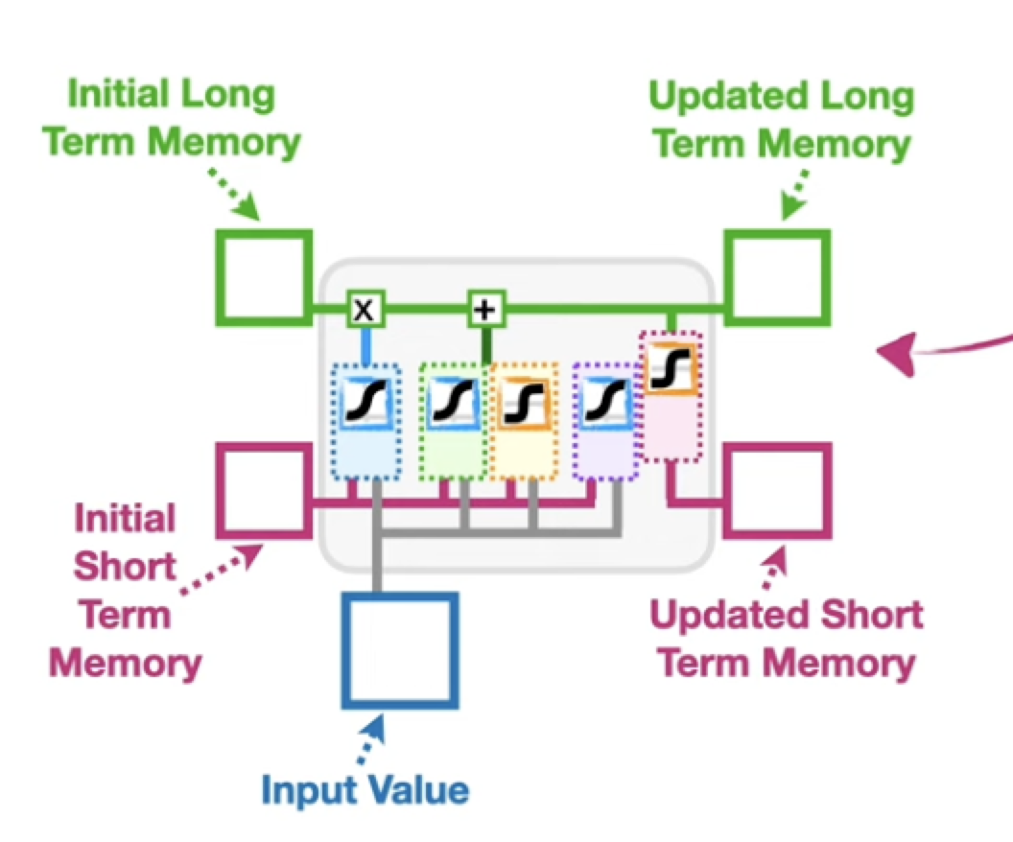
LSTM again

Slide 6
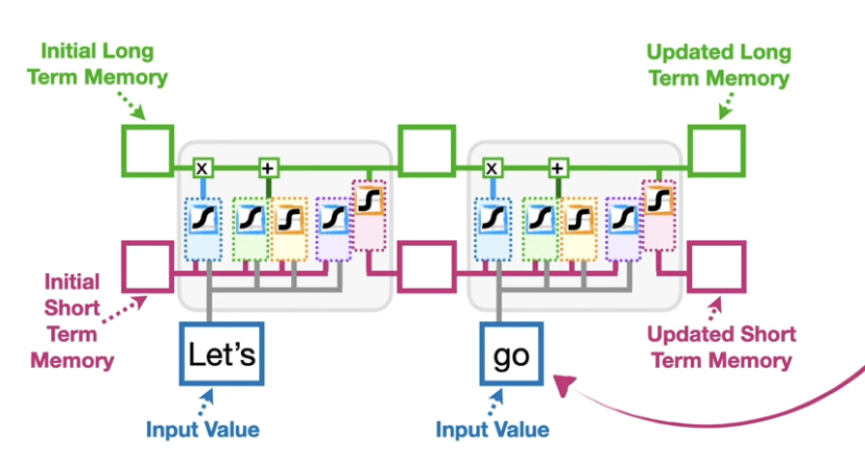
LSTM Chain

Slide 7
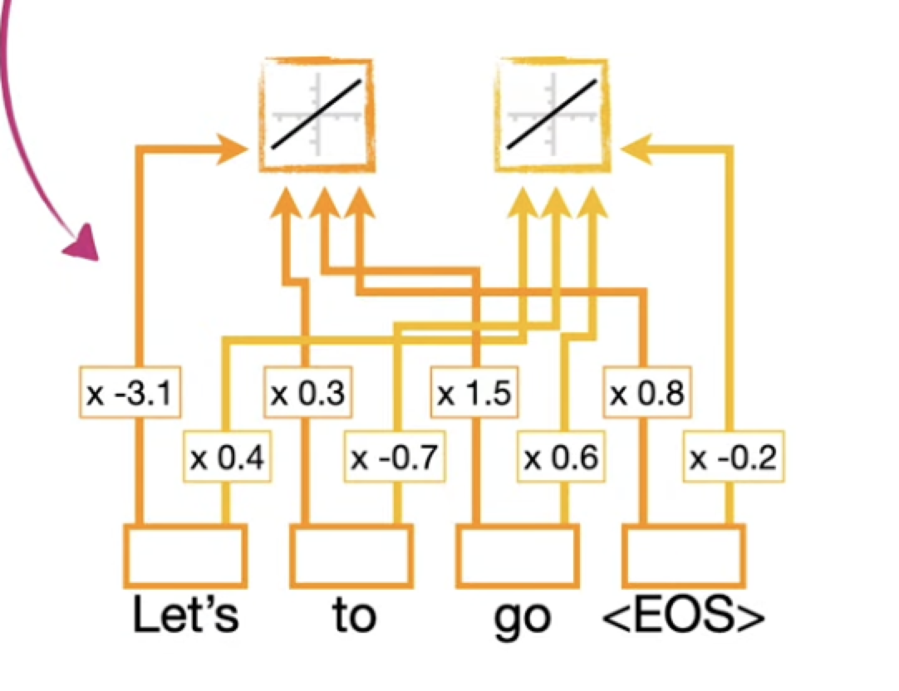
But we cannot put words as they are – Word Embedding

Slide 8
General Concept of Embeddings
Both word2vec and Transformer embeddings aim to represent words (or tokens) as vectors in a continuous vector space. Words with similar meanings should have similar vector representations.
Word2Vec embeddings are static, meaning each word is represented by the same vector regardless of the context in which it appears.
Transformer embeddings are often learned during training and are context-sensitive. This means that the vector representation of a word can change depending on the surrounding words. For instance, in models like BERT or GPT, the same word will have different embeddings based on its context in different sentences.

Slide 9
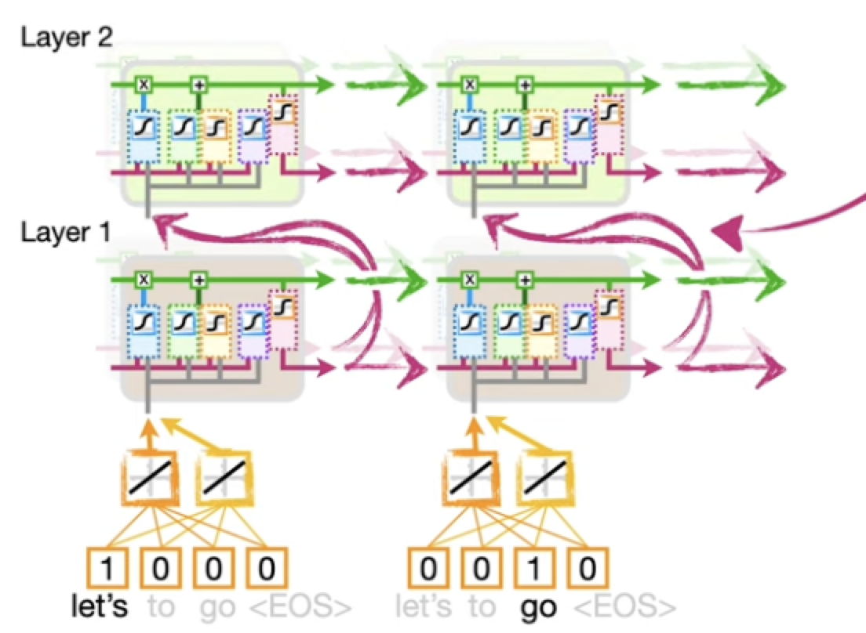
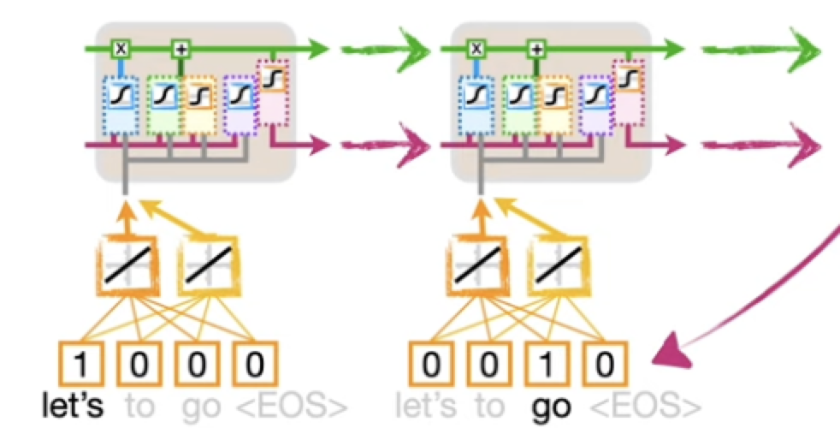
Encoder with multilayer LSTM and Embedding
In essence, the Encoder encodes the input sentence, Let's go, into a collection of long and short term memories (cell and hidden states), context vector

Slide 10
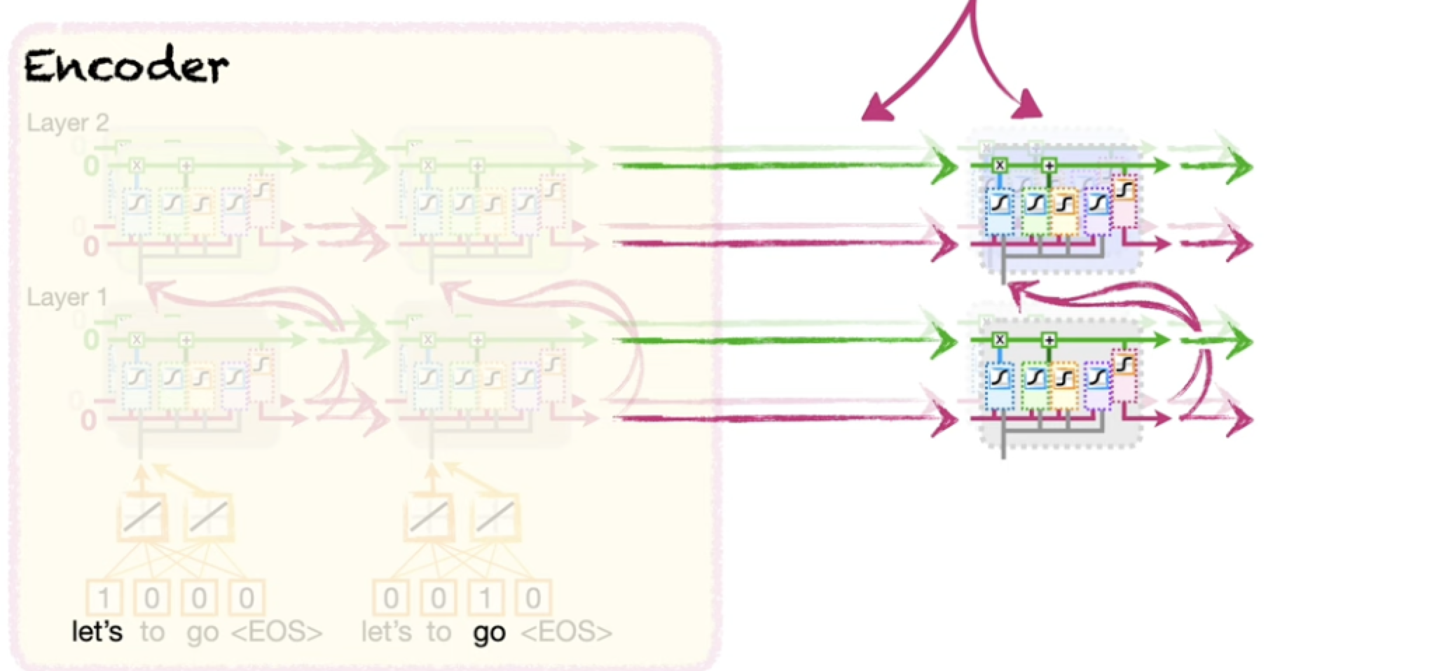
Now we need to decode the context vector
The context vector is used to initialize the long and short-term memories (the cell and the hidden state) is the LSTM in the Decoder . The goal is to decode the Context Vector into output sentence

Slide 11
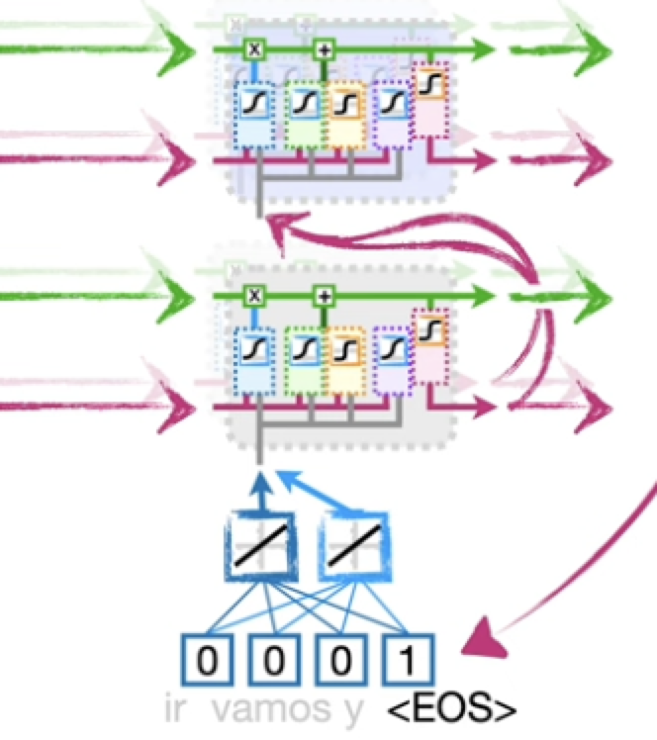
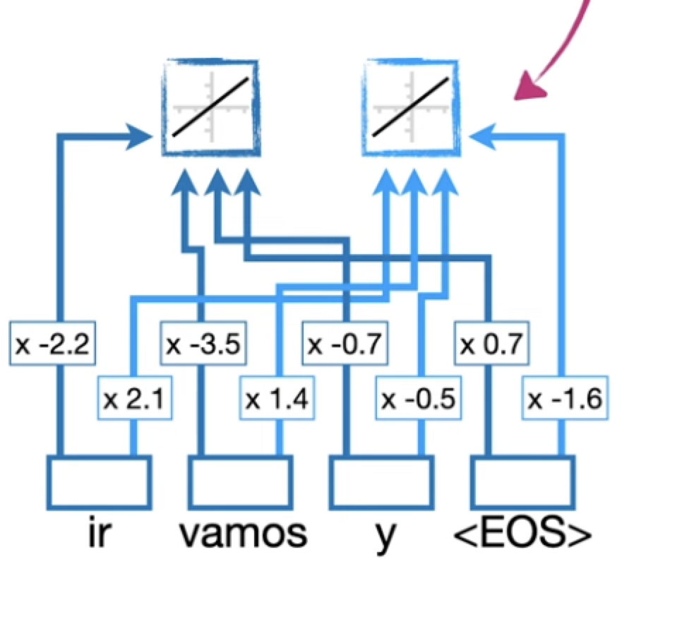
Decoder start with EOS

Slide 12

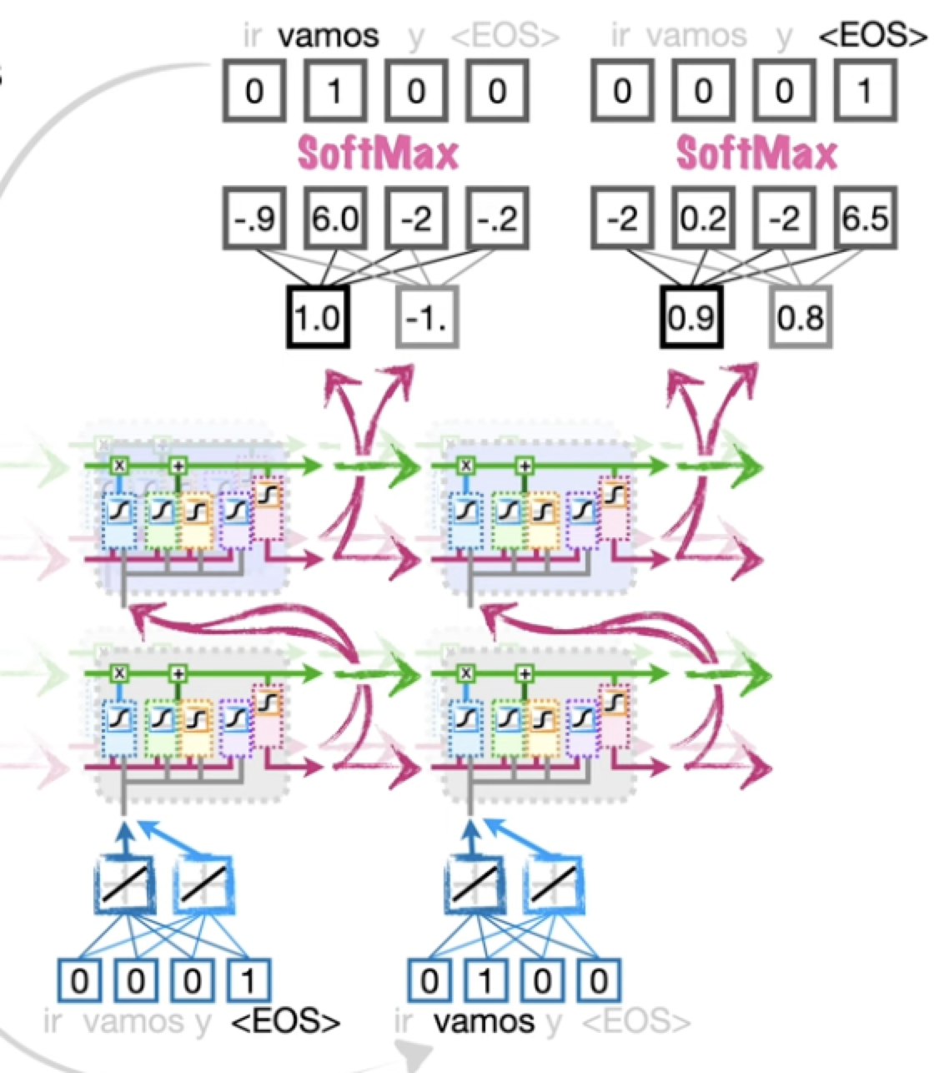
Translation doesn’t stop until EOS

Slide 13
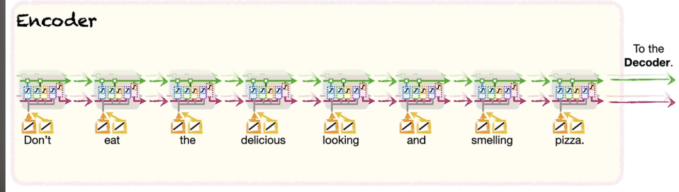
Attention for NNs

Slide 14
For attention and transformer mehanisms
https://youtu.be/PSs6nxngL6k?si=wpjxlHYGYD6bA0HZ
https://youtu.be/PSs6nxngL6k?si=3njJyPRhLOVK_n1E

Slide 15
And to see the basics of LLM Universe
https://youtu.be/zjkBMFhNj_g?si=kJV_jbDWr1-uI-XP

